Slide 1
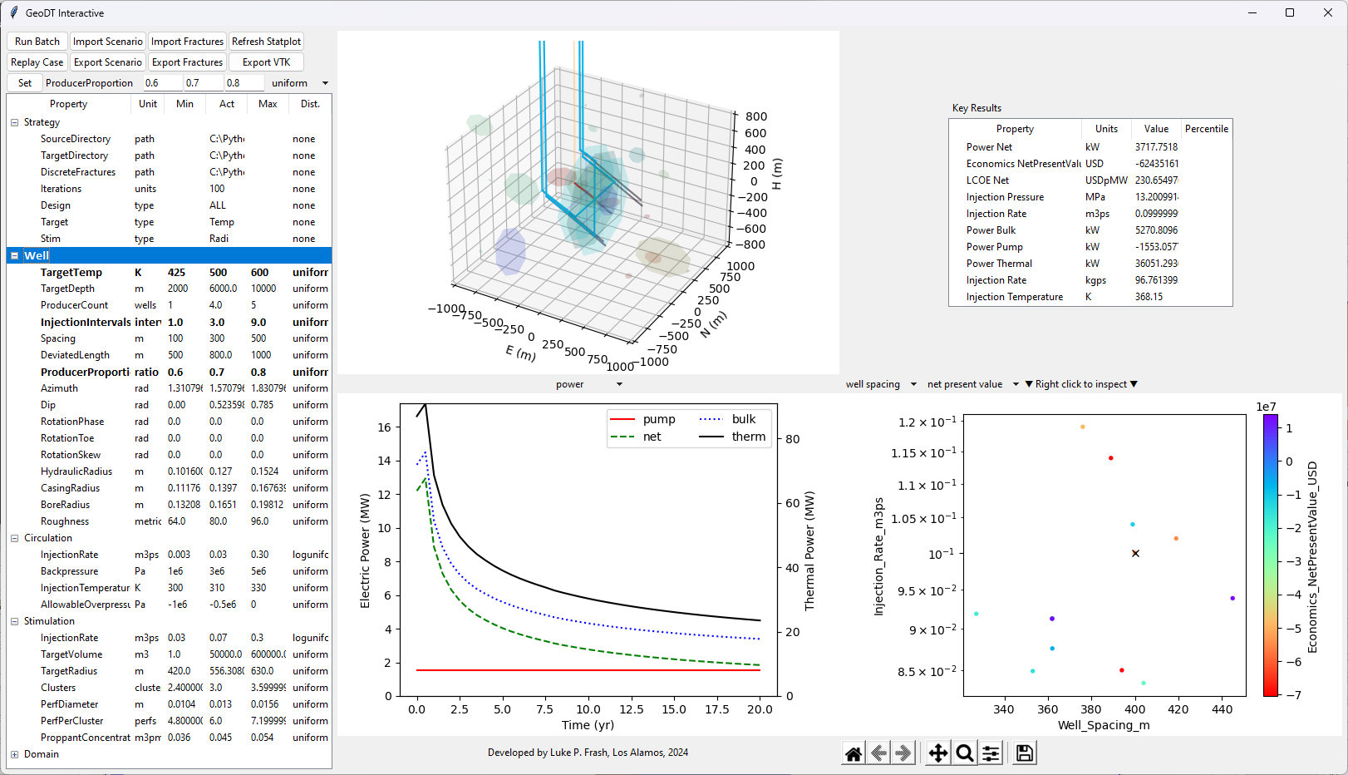
Controls
Geometry
Viewer
Payoff
Metrics
Setup Explorer
Time
Viewer
Multi-model
Inspector

Slide 2
Model Settings (*.set)
Model Settings (*.set)
Fractures and Wells
Geomechanics
Flow Solver
Heat Solver
Power Conversion
Outputs (*.csv, *.vtk, *.geodt)

